Slide 1

Pros and Cons of Compositional Forced-Choice Measurement
Thielges, Austin¹ & Zhang, Bo^{1,2}
¹Department of Psychology, University of Illinois Urbana-Champaign
²School of Labor and Employment Relations, University of Illinois Urbana-Champaign
1

Slide 2
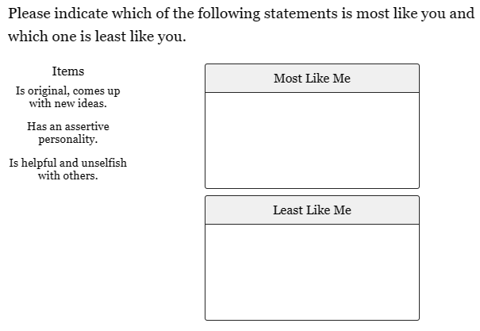
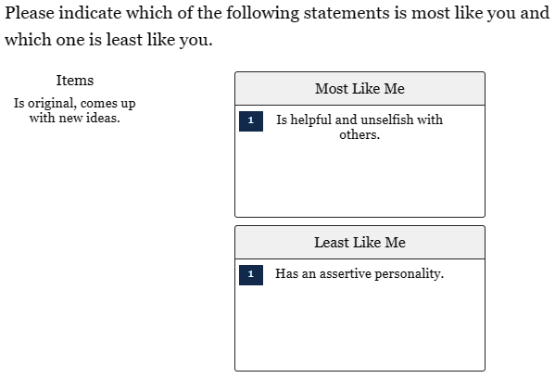
Traditional Forced-Choice Measurement (TFC)
2
Notes:
Traditional forced-choice measurement involves respondents making relative judgements between statements.
For example, here we give respondents three statements to compare.
We ask them to identify which of the three statements is most like them and which is least like them.

Slide 3
Benefits of TFC Measurement (vs. Likert)
Resistance to faking in high stakes situations
Resistance to response biases:
  extreme response style
  middle response style
  leniency
  acquiescence
  …
3
Notes:
Faking refers to individuals responding in a socially desirable way instead of honestly in high stakes situations.
For instance, to make themselves look good when applying for a job.
This is because of the relative indication they are forced to make between the statements rather than absolute.

Slide 4
Limitations of TFC Measurement
Lower reliability
Less favorable respondent reactions
Can introduce randomness
4
Notes:
There are a few notable limitations to traditional forced-choice measurement:
Lower reliability compared its Likert counterpart.
Less favorable respondent reactions, such as enjoyment, perceived utility, and cognitive demand, for example. Making people choose between statements may cause more negative reactions.
Traditional forced choice can also introduce randomness into individuals’ responses by forcing them to choose between statements that it may be difficult for them to decide between. In that situation, they may choose one randomly.

Slide 5
Compositional Forced-Choice (CFC) Measurement
Distribution of points
Fixed number
Indicating relative preference
5
Notes:
Compositional forced-choice measurement involves the distribution of a fixed number of points across multiple statements.
Here, fixing the number of points individuals have to spread across the statements maintains the relative indication of preference that is characteristic of forced choice.

Slide 6
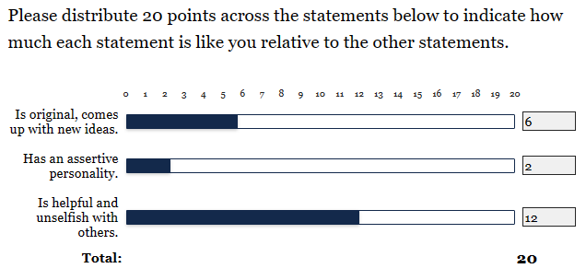
Compositional FC Example
6
Notes:
Here, we have three statements again like in traditional forced choice, but now individuals are given 20 points to distribute across the statements rather than just indicating the order of preference.

Slide 7
Potential Benefits of CFC Measurement
Higher reliability than TFC
More favorable respondent reactions
Maintain the benefits of TFC
  Resistance to faking
  Resistance to response biases
7
Notes:
Compositional forced-choice measurement may allow us to achieve higher reliability than traditional forced-choice measurement.
Using compositional forced-choice could result in more favorable respondent reactions. Participants are not forced to choose between statements as harshly, and they are able to indicate some variation in the degree to which a statement is more or less like them.
Compositional forced choice could allow us to maintain the benefits of traditional forced choice while allowing for relative indication of preferences. So, we can allow for variability in preference for statements without having to return to the Likert format.

Slide 8
CFC Considerations
May require more effort
  Increased cognitive demand
Cognitive ability as potential confound
8
Notes:
There are a few considerations to keep in mind with compositional forced choice measurement.
It may require more effort from respondents because they have to think about distributing the points and the extent to which they think one statement is more or less like them than another. This could result in increased cognitive demand, and subsequent reductions in respondent reactions if they find the measure to be too difficult or tiring.
Additionally, cognitive ability could be a confounding variable influencing personality scores. Having to think about the right way to distribute points could cause individuals to respond differently based on their cognitive ability level.

Slide 9
Purpose of Study
Potential of CFC for assessing personality
No current empirical study
Benefits of CFC
Limitations of CFC
9
Notes:
Evaluate the potential of compositional forced-choice measurement for assessing personality.
There is currently no empirical study evaluating the benefits and limitations of CFC.
There is a need to conduct a study to determine which of these potential benefits and limitations are present and how influential they may be.

Slide 10
The Present Study
Examine potential benefits and limitations
Compare Likert and CFC conditions
  Their psychometric properties
  Respondent reactions
  Potential cognitive ability interference
  Completion time
10
Notes:
In the present study, we will examine these potential benefits and limitations of compositional forced-choice measurement.
We will compare the Likert scale format and 2 CFC formats with respect to:
Their psychometric properties (including model fit, reliability, convergent validity, and criterion-related validity).
Respondent reaction differences between the CFC measures (for CFC conditions only).
Potential cognitive ability interference.
and Completion time.

Slide 11
Sample
Prolific Sample
  377 individuals
  Mean Age: 37.25 (SD = 12.09)
  Gender: 182 male, 153 female, 42 missing/other
  Mean Work Experience: 15.15 years (SD = 11.14)
  Employment: 175 full time (35+ hours/week), 34 part time, 41 self-employed, 43 unemployed
11
Notes:
END of Employment: all others missing or combination.

Slide 12
Conditions
Faking and Honest Conditions (Within-Subject)
  2-week interval
  Counterbalanced order
CFC Conditions (Between-Subject)
  20 points (CFC-20)
  100 points (CFC-100)
12
Notes:
In this study, there are both within- and between-subjects conditions.
For the within-subjects condition, participants were instructed to respond to personality measures as if they are applying for a job and for ‘self-exploration’. These will be referred to as respectively, the faking and honest conditions.
There was at least a 2-week interval between administrations and the order of the faking or honest condition was counterbalanced.
Participants were also randomly assigned to a compositional forced choice condition.
They were given either 20 or 100 points to distribute across the statements to be compared. These will be referred to as the CFC-20 condition and the CFC-100 condition.
A Likert scale of the same personality measure was taken in both of these conditions.

Slide 13
Measures
Big Five Inventory – 2 (Soto & John, 2016)
Job Performance (Williams & Anderson, 1991)
Organizational Citizenship Behavior (Williams & Anderson, 1991)
Counterproductive Work Behavior (Items 1-3 from Bennett & Robinson, 2000; Item 4 from Williams & Anderson, 1991)
Withdrawal (Item 1 from Williams & Anderson, 1991; Items 2-4 from Hanisch & Hulin, 1990)
Turnover Intentions (Crossley et al., 2002)
Job Satisfaction (Spector, 1985)
Subjective Well-Being (Diener et al., 1985)
General Mental Ability (GMA-60; Arthur, 2017)
13
Notes:
BFI-2: 60 statements assessing openness, conscientiousness, extraversion, agreeableness, and neuroticism (which will be reversed and referred to as emotional stability for ease of interpretation).
It is important to note that not all measures will be taken in the faking condition.
In the faking condition, participants will only take the big five inventory and respondent reaction measures.
In the honest condition, participants will take all of the measures.

Slide 14
Respondent Reaction Measures
The respondent reaction measures assess:
  Perceived Accuracy
  Perceived Difficulty
  Enjoyment
  Cognitive Demand
  Perceived Fakability
  Perceived Utility
Different between faking and honest conditions
14
Notes:
They are different between the faking and honest conditions because the faking condition respondent reaction measure is designed specifically for high stakes situations.
They both assess the same respondent reactions, but in different ways.

Slide 15
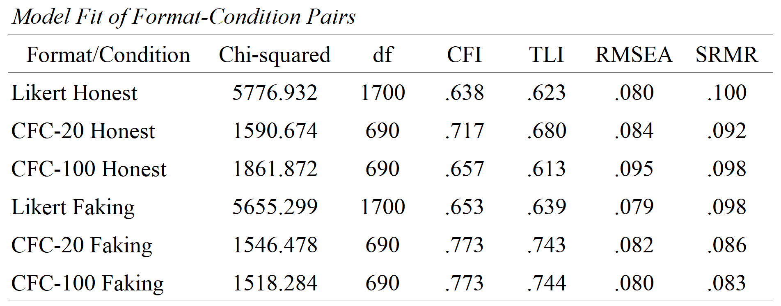
Model Fit
15
Notes:
Fit correlated factors model to Likert data.
Fit compositional data model developed by Brown (2016) to CFC data.
Notable Trends:
CFI, TLI, and SRMR support superior model fit for the compositional forced choice scales.
RMSEA supported better model fit for the Likert scale in the honest condition, but they were all comparable for the faking condition.
CFC-100 honest showed lower fit than that displayed by the other CFC conditions.
But overall, the CFC conditions showed greater fit.

Slide 16
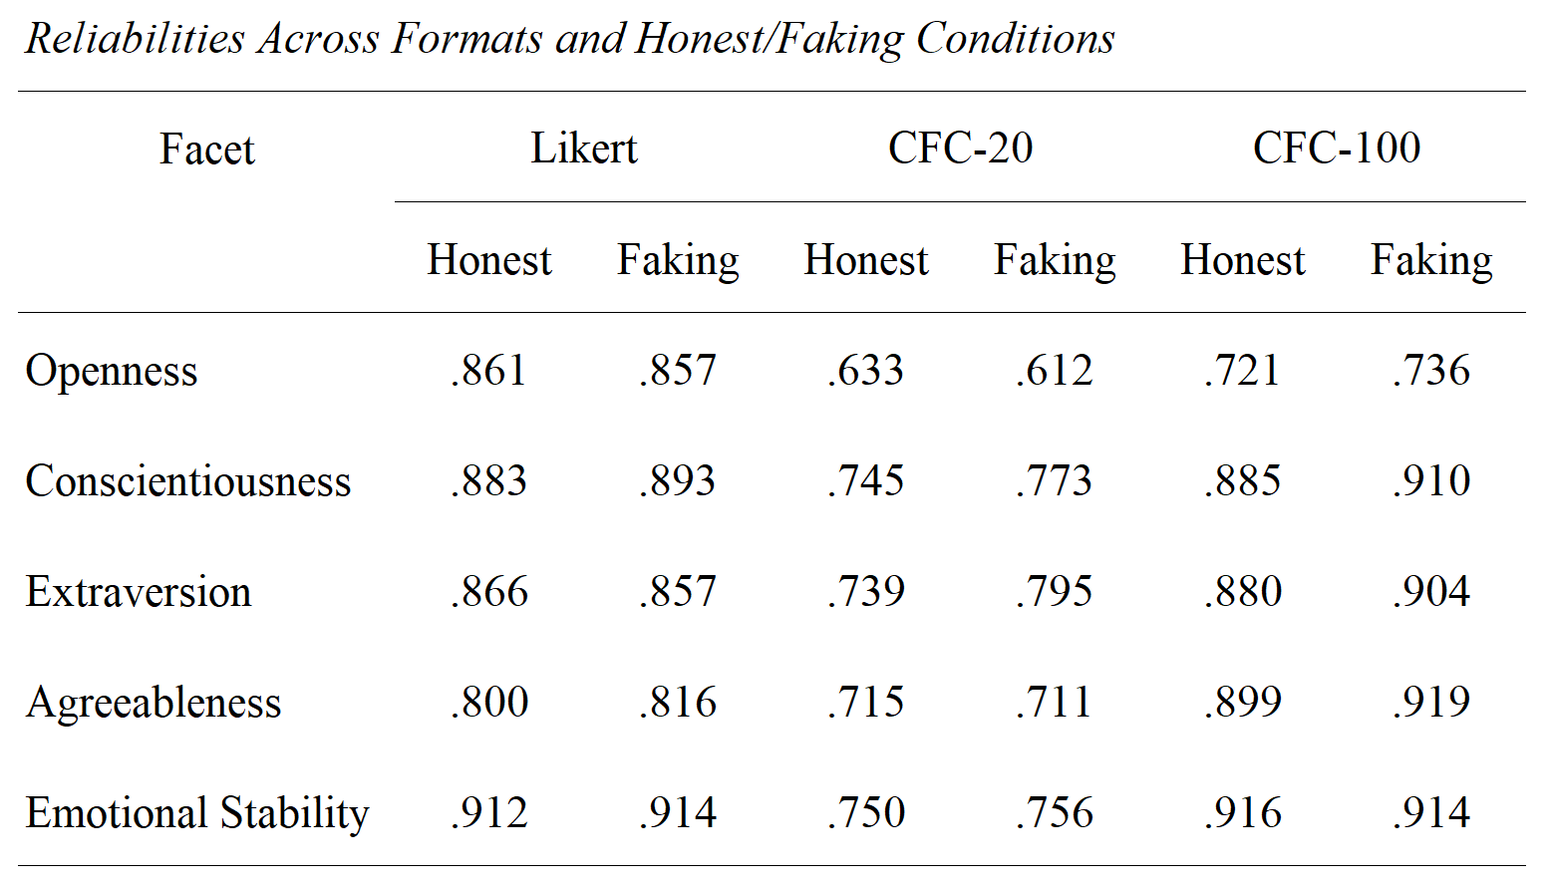
Reliability
16
Notes:
CFC-20 displayed lower levels of reliability across both honest and faking conditions.
CFC-100 showed comparable or greater levels of fit across most of the personality facets.
But, the openness facet specifically showed lower levels of reliability in both of the CFC conditions.
CFC-100 was a little better than CFC-20, but still not up to par with the Likert measure.

Slide 17
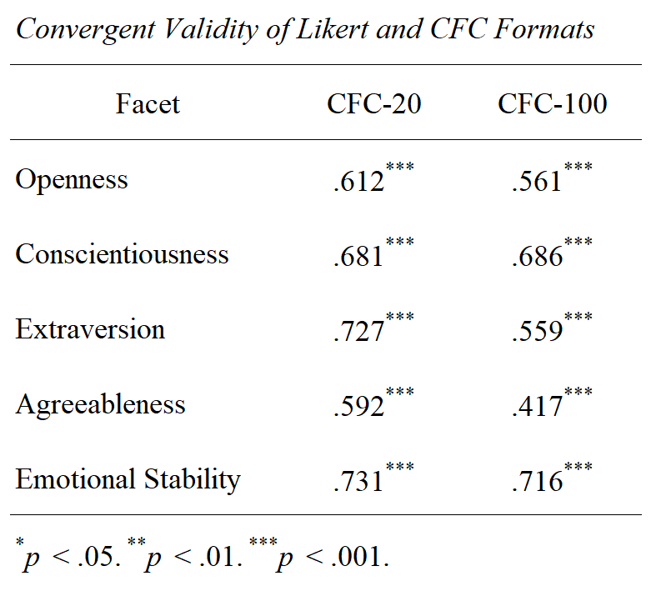
Convergent Validity
17
Notes:
CFC-20 showed greater convergent validity with the Likert personality scores.
CFC-100 was particularly lower in extraversion and conscientiousness, and somewhat so in openness.
Convergent validity was calculated using the honest condition scores.

Slide 18
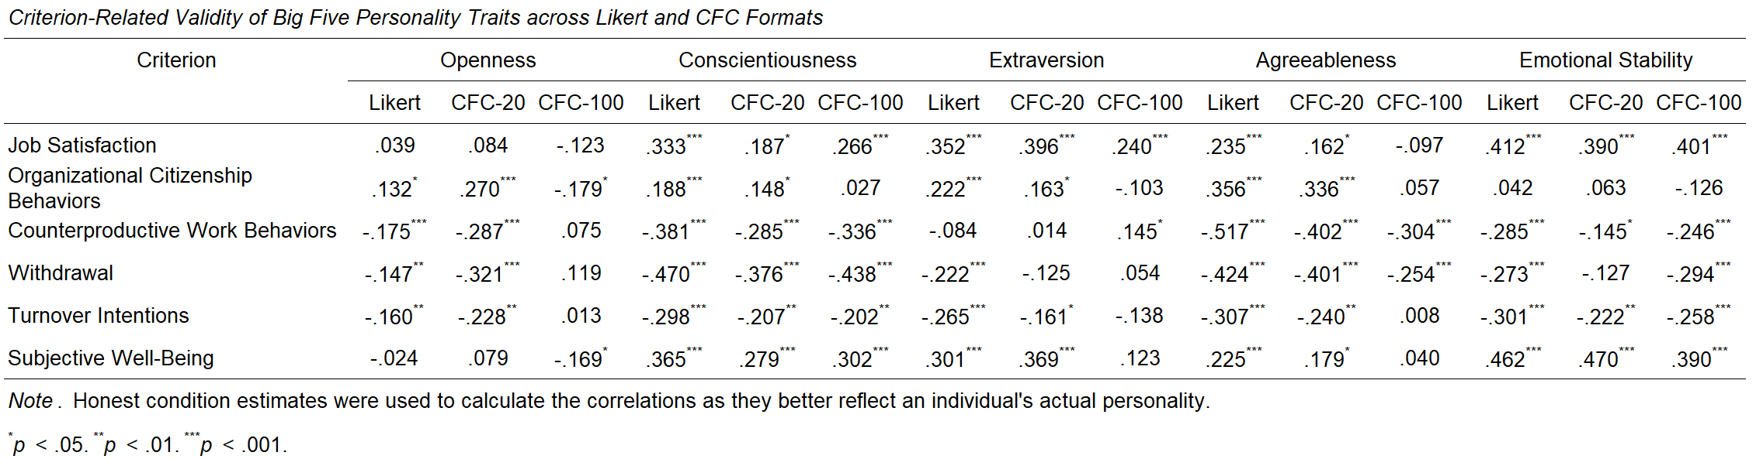
Criterion-Related Validity
18
Notes:
We looked at the criterion-related validity of 6 criterion.
Highlighting here reflects a difference in the trend compared to the Likert format.
This could mean that it is significant but in the opposite direction, not significant when Likert is, or significant when Likert is not. So, essentially a departure from the Likert format’s results.
CFC-100 specifically had issues with criterion-related validity compared to the Likert format in openness, extraversion, and agreeableness.
We see that there are a few other spots, two for CFC-20 and one for CFC-100, but no other large issues.

Slide 19
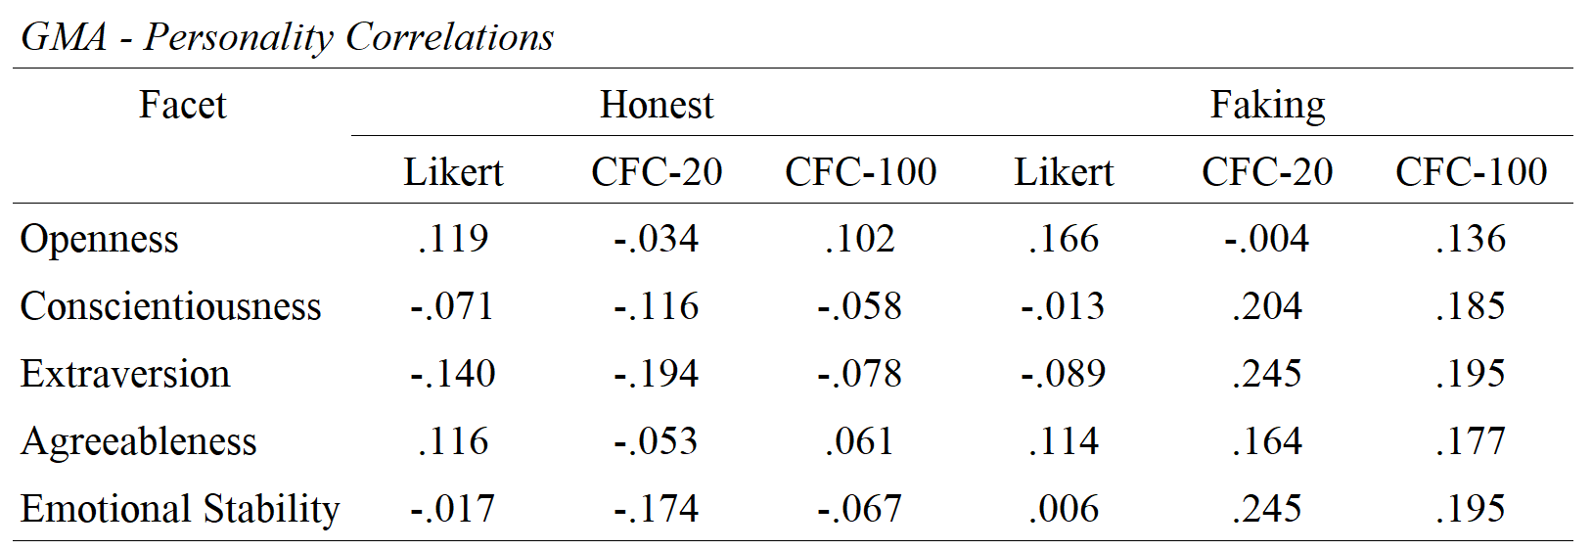
Cognitive Ability
19
Notes:
For cognitive ability, we see comparable amounts of correlations above .1 for the honest condition across Likert and CFC-20, but only 1 in CFC-100.
In the faking condition, we see nearly all of the personality facets being correlated above .1 in the CFC-20 and CFC-100 conditions.
The Likert format only has 2 of the 5 correlated above .1
So, we see potential cognitive ability interference with the personality facet levels, specifically in the CFC faking conditions.

Slide 20
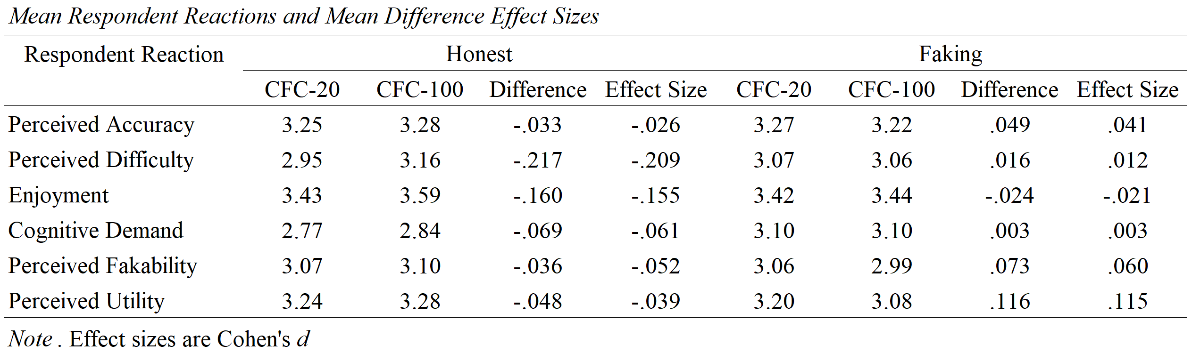
Respondent Reactions
20
Notes:
Respondent reactions, for the most part, are not much different across CFC-20 and CFC-100.
The only notable effect sizes for the difference between respondent reactions is for perceived difficulty and enjoyment in the honest condition, indicating that individuals found CFC-100 to be more difficult and more enjoyable.
And in perceived utility in the faking condition, in which the CFC-20 format showed greater perceived utility.

Slide 21
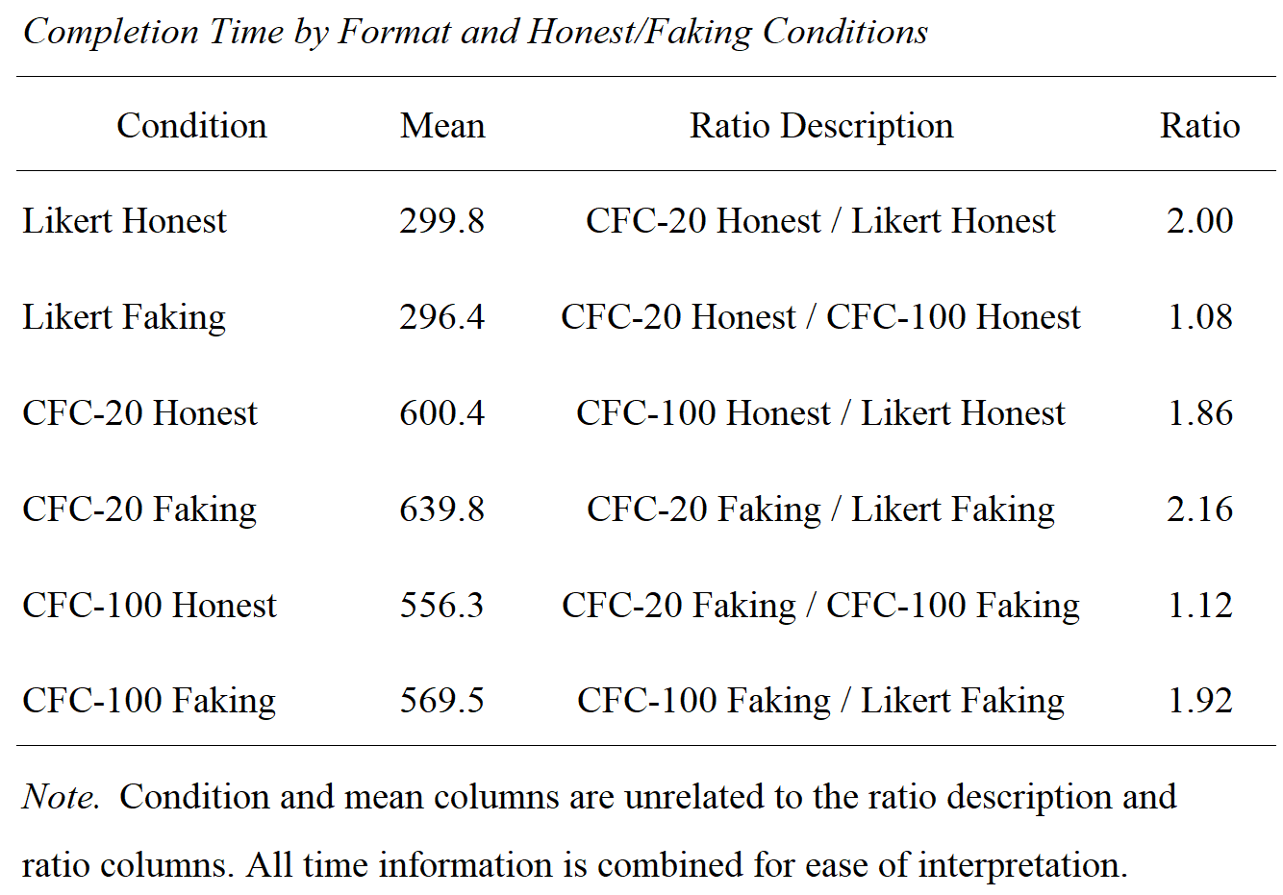
Completion Time
21
Notes:
The Likert scales took approximately 300 seconds to complete.
The CFC scales took approximately 550-600 seconds to complete.
The CFC scales take around 2 times longer to complete than the Likert scales.
CFC-20 and CFC-100 are comparable, with CFC-20 taking slightly longer.

Slide 22
Usefulness of Compositional Forced-Choice
Mixed view of CFC usefulness
Higher model fit
Low reliability in CFC-20
CFC-100 worse criterion-related and convergent validity
CFC formats take significantly more time
22
Notes:
Overall, the results provide a mixed view of the usefulness of compositional forced-choice measurement over the Likert format.
CFC formats provide greater model fit than the Likert format.
CFC-20 falls short in terms of reliability.
CFC-100 falls short in criterion-related validity compared to the Likert format and convergent validity compared to CFC-20.
In addition, the CFC formats take significantly more time to complete than the Likert format.

Slide 23
The Future of CFC Measurement
More work needs to be done
Direct comparison with TFC
Variation in number of points
Yet to be fully evaluated
23
Notes:
More work needs to be done to examine the comparability, benefits, and limitations of compositional forced-choice measurement.
This includes a direct comparison with the traditional forced-choice format.
Variation in the number of points given to participants to distribute across the statements should continue to be explored as we saw differences between the 20 and 100 point conditions.
The usefulness of compositional forced-choice is yet to be fully evaluated, and its future potential for measuring personality depends on the favorability of these evaluations.

Slide 24
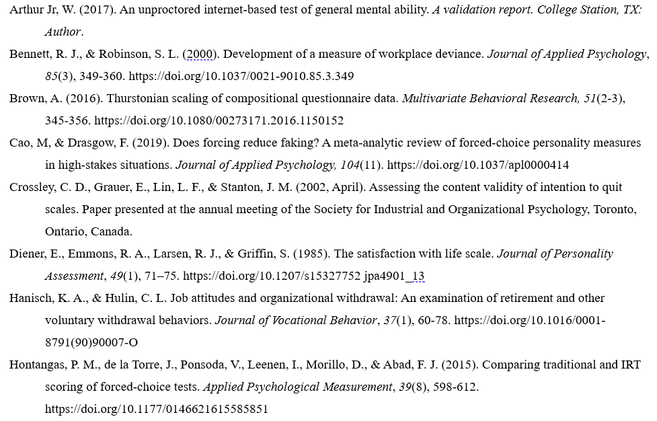
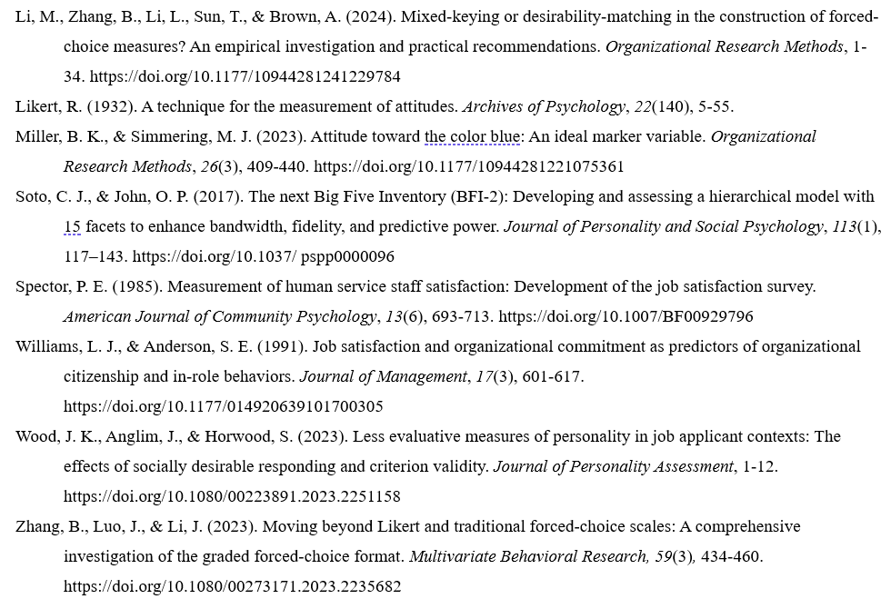
References

